Slide 1
UNIT-5 NOSQL
Introduction to NOSQL Systems, The CAP Theorem, Document-Based NOSQL Systems and MongoDB, NOSQL Key-Value Stores, Column-Based or Wide Column NOSQL Systems, NOSQL Graph Databases and Neo4j
Dr. Manjunatha Swamy C
Associate Professor, Dept. of ADSE
B3 F1 325 Cabin -54

Slide 2
Introduction to NOSQL Systems
NoSQL databases store data in documents (JSON format) rather than relational tables.
NoSQL stands for “not only SQL” rather than “no SQL” at all.
NoSQL databases are built to be flexible, scalable, and capable of rapidly responding to the data management demands of modern businesses.
Most popular types of NoSQL databases: pure document databases, key-value stores, wide-column databases, and graph databases.
NoSQL databases are built from the ground up to store and process vast amounts of data at scale and support a growing number of modern businesses.

Slide 3
Why NoSQL?
Today’s web, mobile, and IoT applications need to
  Support large numbers of concurrent users (tens of thousands, perhaps millions)
  Deliver highly responsive experiences to a globally distributed base of users
  Be always available – no downtime (As more customers are going online)
  Handle semi- and unstructured data (As big data is getting bigger)
  Rapidly adapt to changing requirements with frequent updates and new features

Slide 4
Global 2000 enterprises are rapidly embracing NoSQL databases to power their mission-critical applications:
  Tesco, Europe’s No. 1 retailer, deploys NoSQL for e-commerce, product catalog, and other applications
  Ryanair, the world’s busiest airline, uses NoSQL to power its mobile app serving over 3 million users
  Marriott deploys NoSQL for its reservation system that books $38 billion annually
  Gannett, the No. 1 U.S. newspaper publisher, uses NoSQL for its proprietary content management system, Presto
  GE deploys NoSQL for its Predix platform to help manage the Industrial Internet

Slide 5
History of NOSQL
1998- Carlo Strozzi use the term NoSQL for his lightweight, open-source relational database
2000- Graph database Neo4j is launched
2004- Google BigTable is launched
2005- CouchDB is launched
2007- The research paper on Amazon Dynamo is released
2008- Facebooks open sources the Cassandra project
2009- The term NoSQL was reintroduced

Slide 6
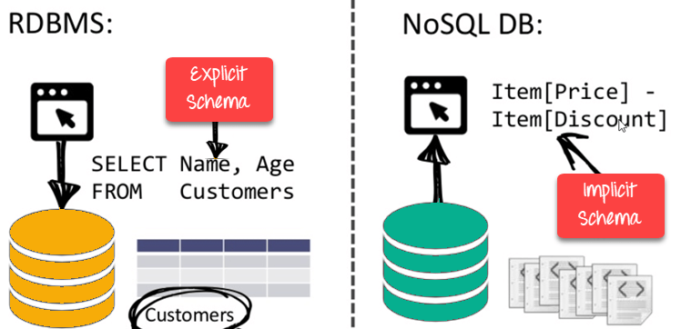
Features of NOSQL
Non-relational
NoSQL databases never follow the relational model
Never provide tables with flat fixed-column records
Work with self-contained aggregates or BLOBs
Doesn’t require object-relational mapping and data normalization
No complex features like query languages, query planners,referential integrity joins, ACID
Schema-free
NoSQL databases are either schema-free or have relaxed schemas
Do not require any sort of definition of the schema of the data
Offers heterogeneous structures of data in the same domain

Slide 7
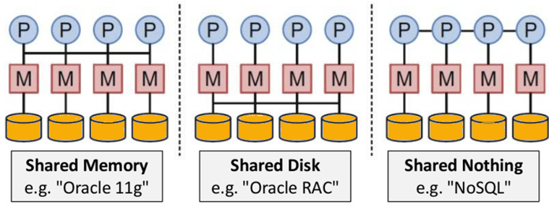
…..Contd
Simple API
Offers easy to use interfaces for storage and querying data provided
APIs allow low-level data manipulation & selection methods
Text-based protocols mostly used with HTTP REST with JSON
Mostly used no standard based NoSQL query language
Web-enabled databases running as internet-facing services
Distributed
Multiple NoSQL databases can be executed in a distributed fashion
Offers auto-scaling and fail-over capabilities
Often ACID concept can be sacrificed for scalability and throughput
Mostly no synchronous replication between distributed nodes Asynchronous Multi-Master Replication, peer-to-peer, HDFS Replication
Only providing eventual consistency
Shared Nothing Architecture. This enables less coordination and higher distribution.

Slide 8
Why relational databases fall short
RDBMS | NoSQL
RDBMS store data in columns and rows | NoSQL databases store data in documents (JSON format) rather than relational tables.
Relational DBMS (database management systems) were born in the era of mainframes and business applications – long before the internet, the cloud, big data, mobile, and today’s massively interactive enterprise. These databases were engineered to run on a single server – the bigger, the better. The only way to increase the capacity of these databases was to upgrade the servers – processors, memory, and storage – to scale up. The failure of server brings down the entire database. | But NoSQL adds commodity servers on demand so the hardware resources match the application load. If an instance fails, the application can send requests to a different one.
In relational databases, the data model is fixed and defined by a static schema. So in order to change the data model, developers have to modify the schema, or worse, request a “schema change” from the database administrators. This slows down or stops development, not only because it's a manual, time-consuming process, but also because it impacts other applications and services. | By contrast, a NoSQL database fully supports agile development and does not statically define how the data must be modeled. The data model is defined by the application model. Applications and services model data as objects. The need to develop with agility, to meet changing requirements, and to eliminate data transformation.
Requires separate software to replicate the data to other data centers | Data replication between data centers is fully built-in and bi-directional

Slide 9
Example
Suppose a client needs a database design for his blog/website and see the differences between RDBMS and MongoDB schema design. Website has the following requirements.
Every post has the unique title, description and url.
Every post can have one or more tags.
Every post has the name of its publisher and total number of likes.
Every post has comments given by users along with their name, message, data-time and likes.
On each post, there can be zero or more comments.

Slide 10
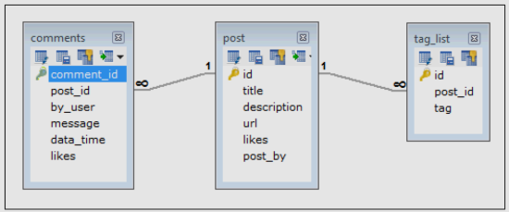
In RDBMS schema, design for above requirements will have minimum three tables.

Slide 11
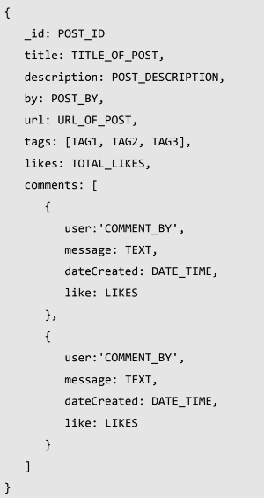
In MongoDB schema, design will have one collection post and the following structure:

Slide 12
The CAP Theorem
Consistency - Consistency refers to every client having the same view of the data.
Availability - Availability means that each read or write request for a data item will either be processed successfully or will receive a message that the operation cannot be completed.
Partition tolerance - Partition tolerance means that the system can continue operating even if the network connecting the nodes has a fault that results in two or more partitions, where the nodes in each partition can only communicate among each other. That means, the system continues to function and upholds its consistency guarantees in spite of network partitions.
The CAP theorem states that it is not possible to guarantee all three of the desirable properties – consistency, availability, and partition tolerance at the same time in a distributed system with data replication.

Slide 13
Relationship of RDBMS with MongoDB
The following table shows the relationship of RDBMS terminology with MongoDB.
RDBMS | MongoDB
Database | Database
Table | Collection
Tuple/Row | Document
column | Field
Table Join | Embedded Documents
Primary Key | Primary Key (Default key _id provided by MongoDB itself)
Database Server and Client
mysqld/Oracle |  | mongod
mysql/sqlplus |  | mongo

Slide 14
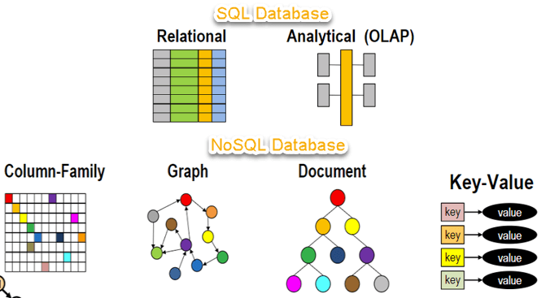

Slide 15
Types of NoSQL Databases
NoSQL Databases are mainly categorized into four types: Key-value pair, Column-oriented, Graph-based and Document-oriented. Every category has its unique attributes and limitations. None of the above-specified database is better to solve all the problems. Users should select the database based on their product needs.
Types of NoSQL Databases:
  Key-value Pair Based
  Column-oriented Graph
  Graphs based
  Document-oriented

Slide 16
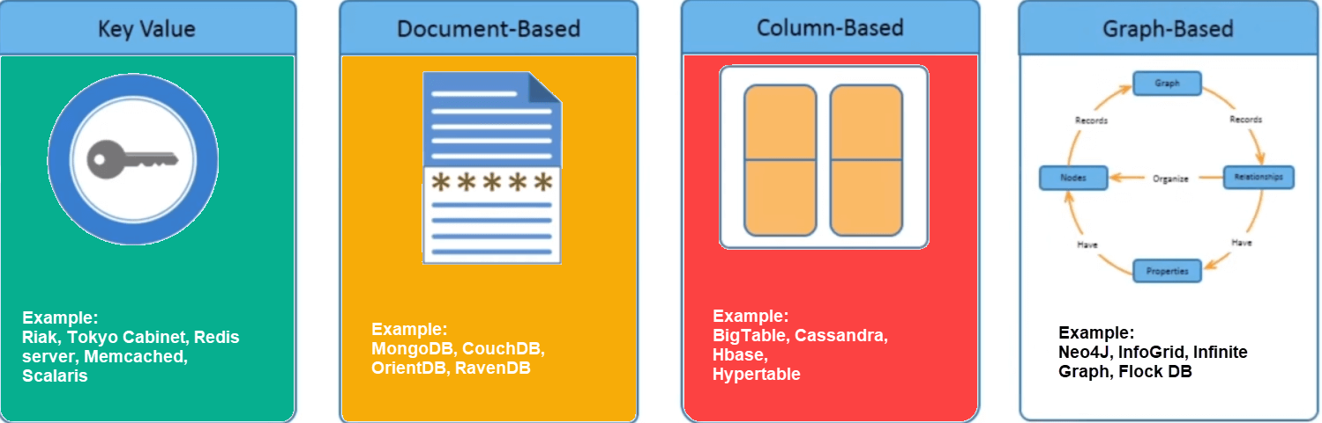

Slide 17
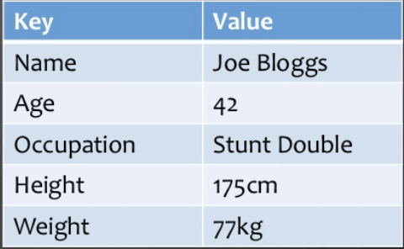
1. Key Value Pair Based Databases
Data is stored in key/value pairs. It is designed in such a way to handle lots of data and heavy load.
Key-value pair storage databases store data as a hash table where each key is unique, and the value can be a JSON, BLOB(Binary Large Objects), string, etc.
For example, a key-value pair may contain a key like “Website” associated with a value like “Guru99”.
It is one of the most basic NoSQL database example.
This kind of NoSQL database is used as a collection, dictionaries, associative arrays, etc. Key value stores help the developer to store schema-less data. They work best for shopping cart contents.
Redis, Dynamo, Riak are some NoSQL examples of key-value store DataBases. They are all based on Amazon’s Dynamo paper.

Slide 18
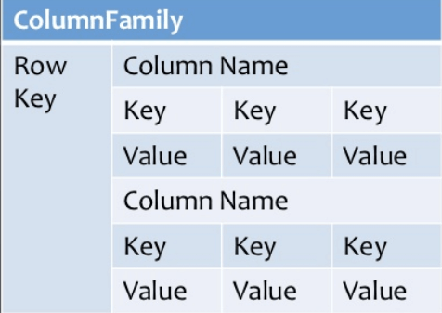
2. Column-based
Column-oriented databases work on columns and are based on BigTable paper by Google. Every column is treated separately. Values of single column databases are stored contiguously.
They deliver high performance on aggregation queries like SUM, COUNT, AVG, MIN etc. as the data is readily available in a column.
Column-based NoSQL databases are widely used to manage data warehouses, business intelligence, CRM, Library card catalogs,
HBase, Cassandra, HBase, Hypertable are NoSQL query examples of column based database.

Slide 19
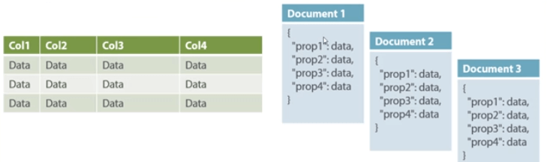
3. Document-Oriented
Document-Oriented NoSQL DB stores and retrieves data as a key value pair but the value part is stored as a document. The document is stored in JSON or XML formats. The value is understood by the DB and can be queried.
In this diagram on your left you can see we have rows and columns, and in the right, we have a document database which has a similar structure to JSON. Now for the relational database, you have to know what columns you have and so on. However, for a document database, you have data store like JSON object. You do not require to define which make it flexible.
The document type is mostly used for CMS systems, blogging platforms, real-time analytics & e-commerce applications. It should not use for complex transactions which require multiple operations or queries against varying aggregate structures.
Amazon SimpleDB, CouchDB, MongoDB, Riak, Lotus Notes, MongoDB, are popular Document originated DBMS systems.

Slide 20
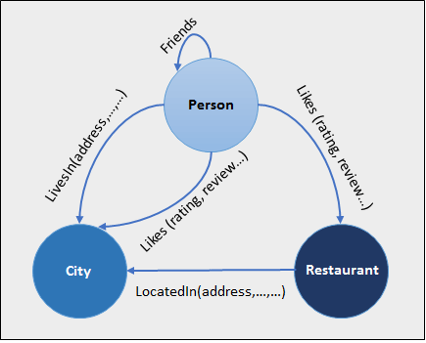
4. Graph-Based
A graph type database stores entities as well the relations amongst those entities. The entity is stored as a node with the relationship as edges. An edge gives a relationship between nodes. Every node and edge has a unique identifier.
Compared to a relational database where tables are loosely connected, a Graph database is a multi-relational in nature. Traversing relationship is fast as they are already captured into the DB, and there is no need to calculate them.
Graph base database mostly used for social networks, logistics, spatial data.
Neo4J, Infinite Graph, OrientDB, FlockDB are some popular graph-based databases.

Slide 21
Advantages of MongoDB over RDBMS
Schema less: MongoDB is a document database in which one collection holds different documents. Number of fields, content and size of the document can differ from one document to another.
Structure of a single object is clear.
No complex joins.
Deep query-ability. MongoDB supports dynamic queries on documents using a document-based query language that's nearly as powerful as SQL.
Tuning.
Ease of scale-out: MongoDB is easy to scale.
Conversion/mapping of application objects to database objects not needed.
Uses internal memory for storing the (windowed) working set, enabling faster access of data.

Slide 22
Why Use MongoDB?
Document Oriented Storage: Data is stored in the form of JSON style documents.
Index on any attribute
Replication and high availability
Auto-sharding
Rich queries
Fast in-place updates
Professional support by MongoDB

Slide 23
Where to Use MongoDB?
Big Data
Content Management and Delivery
Mobile and Social Infrastructure
User Data Management
Data Hub

Slide 24
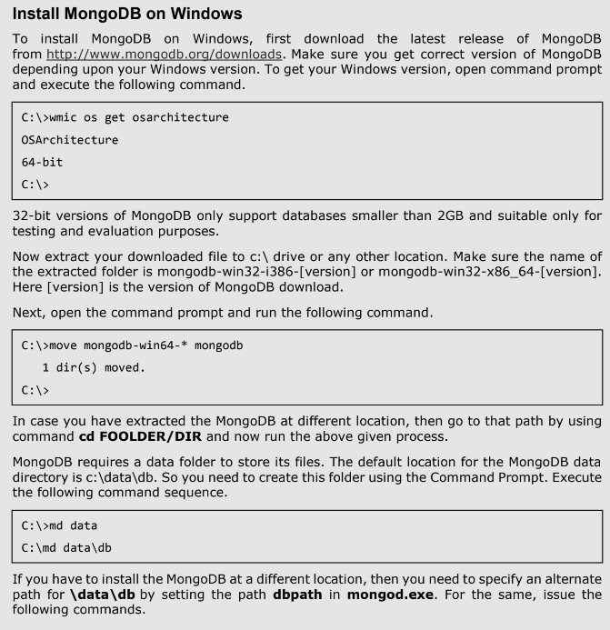
Installing MongoDB

Slide 25
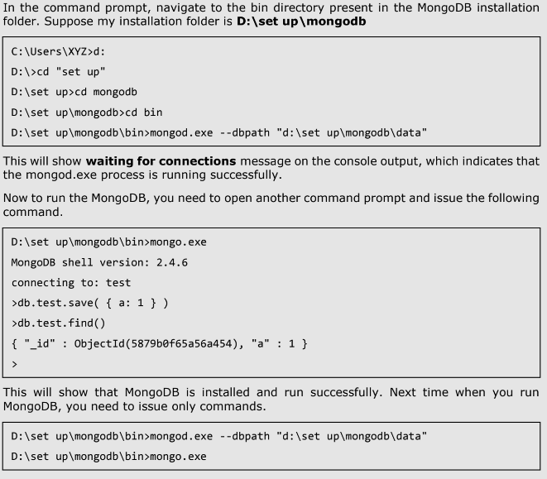

Slide 26
MongoDB is an open-source document database and leading NoSQL database.
MongoDB is written in C++.
MongoDB is a cross-platform, document oriented database that provides, high performance, high availability, and easy scalability.
MongoDB works on concept of collection and document.
Collection is a group of MongoDB documents. It is the equivalent of an RDBMS table. A collection exists within a single database. Collections do not enforce a schema. Documents within a collection can have different fields. Typically, all documents in a collection are of similar or related purpose.
Document is a set of key-value pairs. Documents have dynamic schema. Dynamic schema means that documents in the same collection do not need to have the same set of fields or structure, and common fields in a collection's documents may hold different types of data.

Slide 27
Create/Drop Database
use DATABASE_NAME - to create database. In MongoDB default database is test. If you didn't create any database, then collections will be stored in test database. E.g.: use mydb
db - To check your currently selected database, use the command db
show dbs - to check your databases list. To display database, you need to insert at least one document into it.
db.school.insert({"name":"christ university"})
db.dropDatabase() - to delete the database
db.school.find() – to find the inserted values in school
db.school.find().pretty() – to make the output readable

Slide 28
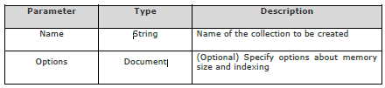
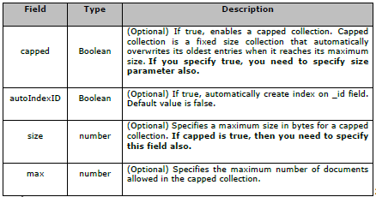
Create/drop Collection
db.createCollection(name, options) - to create collection. In MongoDB, you don't need to create collection. MongoDB creates collection automatically, when you insert some document.
Following is the list of options you can use:
While inserting the document, MongoDB first checks size field of capped collection, then it
checks max field.

Slide 29
test> db.createCollection("mycollection") - to create collection
test> show collections - to check the created collection
syntax of createCollection() method with few important options:
db.createCollection("mycol", { capped : true, size : 6142800,max : 10000 } )
db.mycol.insert({"name":"diana"}) – to insert values into a collection
db.mycol.find() - to see the inserted document
db.mycol.drop() – to drop the collection

Slide 30
Data types
String | This is the most commonly used datatype to store the data. String in MongoDB must be UTF-8 valid.
Integer | This type is used to store a numerical value. Integer can be 32 bit or 64 bit depending upon your server.
Boolean | This type is used to store a boolean (true/ false) value
Double | This type is used to store floating point values
Min/ Max keys | This type is used to compare a value against the lowest and highest BSON elements
Arrays | This type is used to store arrays or list or multiple values into one key
Timestamp | ctimestamp. This can be handy for recording when a document has been modified or added
Object | This datatype is used for embedded documents.
Null | This type is used to store a Null value.
Symbol | This datatype is used identically to a string; however, it's generally reserved for languages that use a specific symbol type.
Date | This datatype is used to store the current date or time in UNIX time format. You can specify your own date time by creating object of Date and passing day, month, year into it.
Object ID | This datatype is used to store the document’s ID.
Binary data | This datatype is used to store binary data.
Code | This datatype is used to store JavaScript code into the document.
Regular expression | This datatype is used to store regular expression.

Slide 31
INSERT method
To insert data into MongoDB collection, you need to use MongoDB's insert() or save() method.
Syntax: db.COLLECTION_NAME.insert(document)
Example:
To insert the document you can use db.post.save(document) also.
If we don't specify the _id parameter, then MongoDB assigns a unique ObjectId for this document. id is 12 bytes hexadecimal number unique for every document in a collection. 12 bytes are divided as follows: _id: ObjectId(4 bytes timestamp, 3 bytes machine id, 2 bytes process id, 3 bytes incrementer)
db.school.insert({id : ObjectId("507f191e810c19729de860ea"),
title: "MongoDB Overview",
description: "MongoDB is no sql database",
by: "Christ University",
url: "http://www.tutorialspoint.com",
tags: ['mongodb', 'database', 'NoSQL'],ikes: 100})

Slide 32
Insertone and insertmany methods
db.COLLECTION_NAME.insertOne(document) - to insert only one document into a collection
Example: db.empDetails.insertOne( { First_Name: "Radhika", Last_Name: "Sharma", Date_Of_Birth: "1995-09-26", e_mail: "radhika_sharma.123@gmail.com", phone: "9848022338" })
db.COLLECTION_NAME.insertMany(document) - to insert many documents into a collection
Example: db.empDetails.insertMany( [ { First_Name: "Radhika", Last_Name: "Sharma", Date_Of_Birth: "1995-09-26", e_mail: "radhika_sharma.123@gmail.com", phone: "9000012345" }, { First_Name: "Rachel", Last_Name: "Christopher", Date_Of_Birth: "1990-02-16", e_mail: "Rachel_Christopher.123@gmail.com", phone: "9000054321" }, { First_Name: "Fathima", Last_Name: "Sheik", Date_Of_Birth: "1990-02-16", e_mail: "Fathima_Sheik.123@gmail.com", phone: "9000054321" } ] )

Slide 33
To insert multiple documents
db.createCollection("helo");
db.helo.insert([
{
title: "MongoDB Overview",
description: "MongoDB is no SQL database",
by: "tutorials point",
url: "http://www.tutorialspoint.com",
tags: ["mongodb", "database", "NoSQL"],
likes: 100
},
{
title: "NoSQL Database",
description: "NoSQL database doesn't have tables",
by: "tutorials point",
url: "http://www.tutorialspoint.com",
tags: ["mongodb", "database", "NoSQL"],
likes: 20,
comments: [
{
user:"user1",
message: "My first comment",
dateCreated: new Date(2013,11,10,2,35),
like: 0
}
]
}
])

Slide 34
find() method
This method is used to query data from MongoDB collection. find() method will display all the documents in a non-structured way.
Syntax: db.COLLECTION_NAME.find()
school> db.school.find();
OUTPUT:
[
{ _id: ObjectId("636352ba13298072e044bc60"), rollno: '25900' },
{
_id: ObjectId("636a01e1afc8cee715fe5b6b"),
title: 'MongoDB Overview',
description: 'MongoDB is no SQL database',
by: 'tutorials point',
url: 'http://www.tutorialspoint.com',
tags: [ 'mongodb', 'database', 'NoSQL' ],
likes: 100
},
{
_id: ObjectId("636a01e1afc8cee715fe5b6c"),
title: 'NoSQL Database',
description: "NoSQL database doesn't have tables",
by: 'tutorials point',
url: 'http://www.tutorialspoint.com',
tags: [ 'mongodb', 'database', 'NoSQL' ],
likes: 20,
comments: [
{
user: 'user1',
message: 'My first comment',
dateCreated: ISODate("2013-12-09T21:05:00.000Z"),
like: 0
}
]
}
]

Slide 35
findOne() method - returns only one document
Syntax: db.COLLECTIONNAME.findOne()
pretty() method
To display the results in a formatted way
Syntax: db.COLLECTION_NAME.find().pretty()

Slide 36
RDBMS Where Clause Equivalents in MongoDB
Operation | Syntax | Example | RDBMS Equivalent
Equality | {<key>:{$eg;<value>}} | db.mycol.find({"by":"tutorials point"}).pretty() | where by = 'tutorials point'
Less Than | {<key>:{$lt:<value>}} | db.mycol.find({"likes":{$lt:50}}).pretty() | where likes < 50
Less Than Equals | {<key>:{$lte:<value>}} | db.mycol.find({"likes":{$lte:50}}).pretty() | where likes <= 50
Greater Than | {<key>:{$gt:<value>}} | db.mycol.find({"likes":{$gt:50}}).pretty() | where likes > 50
Greater Than Equals | {<key>:{$gte:<value>}} | db.mycol.find({"likes":{$gte:50}}).pretty() | where likes >= 50
Not Equals | {<key>:{$ne:<value>}} | db.mycol.find({"likes":{$ne:50}}).pretty() | where likes != 50
Values in an array | {<key>:{$in:[<value1>, <value2>,……<valueN>]}} | db.mycol.find({"name":{$in:["Raj", "Ram", "Raghu"]}}).pretty() | Where name matches any of the value in :["Raj", "Ram", "Raghu"]
Values not in an array | {<key>:{$nin:<value>}} | db.mycol.find({"name":{$nin:["Ramu", "Raghav"]}}).pretty() | Where name values is not in the array :["Ramu", "Raghav"] or, doesn’t exist at all

Slide 37
AND in MongoDB
To query documents based on the AND condition, you need to use $and keyword.
Syntax: db.mycol.find({ $and: [ {<key1>:<value1>}, { <key2>:<value2>} ] })
Example
db.school.find({$and:[{"title":"MongoDB Overview"},{"by":"tutorials point"}]}).pretty()
Example:
[
{
_id: ObjectId("636a01e1afc8cee715fe5b6b"),
title: 'MongoDB Overview',
description: 'MongoDB is no SQL database',
by: 'tutorials point',
url: 'http://www.tutorialspoint.com',
tags: [ 'mongodb', 'database', 'NoSQL' ],
likes: 100
}
]
For the given example, equivalent where clause will be ' where by = 'tutorials point' AND title = 'MongoDB Overview' '.
You can pass any number of key, value pairs in find clause.

Slide 38
OR in MongoDB
To query documents based on the OR condition, you need to use $or keyword.
Syntax: db.mycol.find({$or: [{key1: value1}, {key2:value2}]}).pretty()
school> db.school.find({$or:[{"by":"tutorials point"},{"title": "MongoDB Overview"}]}).pretty()
[
{
_id: ObjectId("636a01e1afc8cee715fe5b6b"),
title: 'MongoDB Overview',
description: 'MongoDB is no SQL database',
by: 'tutorials point',
url: 'http://www.tutorialspoint.com',
tags: [ 'mongodb', 'database', 'NoSQL' ],
likes: 100
},
{
_id: ObjectId("636a01e1afc8cee715fe5b6c"),
title: 'NoSQL Database',
description: "NoSQL database doesn't have tables",
by: 'tutorials point',
url: 'http://www.tutorialspoint.com',
tags: [ 'mongodb', 'database', 'NoSQL' ],
likes: 20,
comments: [
{
user: 'user1',
message: 'My first comment',
dateCreated: ISODate("2013-12-09T21:05:00.000Z"),
like: 0
}
]
}
]

Slide 39
Using AND and OR Together
The following example will show the documents that have likes greater than 10 and whose title is either 'MongoDB Overview' or by is 'tutorials point'. Equivalent SQL where clause is 'where likes>10 AND (by = 'tutorials point' OR title = 'MongoDB Overview')‘
Example: db.school.find({$or:[{"by":"tutorials point"},{"title": "MongoDB Overview"}]}).pretty()
[
{
_id: ObjectId("636a01e1afc8cee715fe5b6b"),
title: 'MongoDB Overview',
description: 'MongoDB is no SQL database',
by: 'tutorials point',
url: 'http://www.tutorialspoint.com',
tags: [ 'mongodb', 'database', 'NoSQL' ],
likes: 100
},
{
_id: ObjectId("636a01e1afc8cee715fe5b6c"),
title: 'NoSQL Database',
description: "NoSQL database doesn't have tables",
by: 'tutorials point',
url: 'http://www.tutorialspoint.com',
tags: [ 'mongodb', 'database', 'NoSQL' ],
likes: 20,
comments: [
{
user: 'user1',
message: 'My first comment',
dateCreated: ISODate("2013-12-09T21:05:00.000Z"),
like: 0
}
]
}

Slide 40
NOR in MongoDB
To query documents based on the NOR condition, you need to use $nor keyword.
Syntax: db.COLLECTION_NAME.find({$nor: [{key1: value1}, {key2:value2}]})
Example: school> db.school.find({$nor:[{"title": "MongoDB Overview"},{"likes": "100"}]}).pretty()
[
{ _id: ObjectId("636352ba13298072e044bc60"), rollno: '25900' },
{
_id: ObjectId("636a01e1afc8cee715fe5b6c"),
title: 'NoSQL Database',
description: "NoSQL database doesn't have tables",
by: 'tutorials point',
url: 'http://www.tutorialspoint.com',
tags: [ 'mongodb', 'database', 'NoSQL' ],
likes: 20,
comments: [
{
user: 'user1',
message: 'My first comment',
dateCreated: ISODate("2013-12-09T21:05:00.000Z"),
like: 0
}
]
}
]

Slide 41
NOT in MongoDB
Syntax: >db.COLLECTION_NAME.find ({ key: { $not: { value } } })
Example: db.school.find({ "likes":{$not: { $gt: 20 }}}).pretty()
[
{ _id: ObjectId("636352ba13298072e044bc60"), rollno: '25900' },
{
_id: ObjectId("636a01e1afc8cee715fe5b6c"),
title: 'NoSQL Database',
description: "NoSQL database doesn't have tables",
by: 'tutorials point',
url: 'http://www.tutorialspoint.com',
tags: [ 'mongodb', 'database', 'NoSQL' ],
likes: 20,
comments: [
{
user: 'user1',
message: 'My first comment',
dateCreated: ISODate("2013-12-09T21:05:00.000Z"),
like: 0
}
]
}
]

Slide 42
MongoDB Update() Method
The update() method updates the values in the existing document. By default, MongoDB will update only a single document.
Syntax: db.COLLECTION_NAME.update(SELECTION_CRITERIA, UPDATED_DATA)
Example: db.school.update({'title':'MongoDB Overview'},{$set:{'title':'New MongoDB Tutorial'}})
To update multiple documents, you need to set a parameter 'multi' to true.
db.school.update({'title':'MongoDB Overview'},{$set:{'title':'New MongoDB Tutorial'}},{multi:true})
DeprecationWarning: Collection.update() is deprecated. Use updateOne, updateMany, or bulkWrite.
{
acknowledged: true,
insertedId: null,
matchedCount: 1,
modifiedCount: 1,
upsertedCount: 0
}

Slide 43
MongoDB Save() Method
The save() method replaces the existing document with the new document passed in the save() method.
Syntax: db.COLLECTION_NAME.save({_id:ObjectId(),NEW_DATA})

Slide 44
MongoDB findOneAndUpdate() method
To update the values in the existing document
Syntax: db.COLLECTION_NAME.findOneAndUpdate(SELECTIOIN_CRITERIA, UPDATED_DATA)
Example: db.school.findOneAndUpdate({title:'New MongoDB Tutorial'},{$set:{likes:'30',by:'Christ university' }})
{
_id: ObjectId("636a01e1afc8cee715fe5b6b"),
title: 'New MongoDB Tutorial',
description: 'MongoDB is no SQL database',
by: 'Christ university',
url: 'http://www.tutorialspoint.com',
tags: [ 'mongodb', 'database', 'NoSQL' ],
likes: '30'
}

Slide 45
MongoDB updateOne() method
Syntax: db.COLLECTION_NAME.updateOne(<filter>, <update>)
Example: db.school.updateOne({title: 'New MongoDB Tutorial'},{ $set: { likes: '40',description: 'MongoDB is a NOSQL'}})
Output:
{
acknowledged: true,
insertedId: null,
matchedCount: 1,
modifiedCount: 1,
upsertedCount: 0
}

Slide 46
MongoDB updateMany() method
Syntax: db.COLLECTION_NAME.update(<filter>, <update>)
Example: db.school.updateMany({likes:{ $gt: "25" }},{ $set: { likes: '00'}})
{
acknowledged: true,
insertedId: null,
matchedCount: 1,
modifiedCount: 1,
upsertedCount: 0
}

Slide 47
MongoDB - Delete Document
The remove() Method - to remove a document from the collection. remove() method accepts two parameters. One is deletion criteria and second is justOne flag. deletion criteria − (Optional) deletion criteria according to documents will be removed. justOne − (Optional) if set to true or 1, then remove only one document.
Syntax: db.COLLECTION_NAME.remove(DELLETION_CRITTERIA)
Example: db.school.remove({'title':'MongoDB Overview'})
Remove Only One - If there are multiple records and you want to delete only the first record, then set justOne parameter in remove() method.
Syntax: db.COLLECTION_NAME.remove(DELETION_CRITERIA,1)
Remove All Documents - If you don't specify deletion criteria, then MongoDB will delete whole documents from the collection. This is equivalent of SQL's truncate command.
Syntax: db.COLLECTION_NAME.remove()

Slide 48
MongoDB - Projection
In MongoDB, projection means selecting only the necessary data rather than selecting whole of the data of a document. If a document has 5 fields and you need to show only 3, then select only 3 fields from them.
The find() Method - In MongoDB, when you execute find() method, then it displays all fields of a document. To limit this, you need to set a list of fields with value 1 or 0. 1 is used to show the field while 0 is used to hide the fields.
Syntax: db.COLLECTION_NAME.find({},{KEY:1})
Example: db.school.find({},{"title":1,_id:0})
[ {}, { title: 'New MongoDB Tutorial' }, { title: 'NoSQL Database' } ]
Please note _id field is always displayed while executing find() method, if you don't want this field, then you need to set it as 0

Slide 49
MongoDB - Limit Records
The Limit() Method - To limit the records in MongoDB, you need to use limit() method. The method accepts one number type argument, which is the number of documents that you want to be displayed.
Syntax: db.COLLECTION_NAME.find().limit(NUMBER)
Example: db.school.find({},{"title":1,_id:0}).limit(2)
MongoDB Skip() Method - to skip the number of documents.
Syntax: db.COLLECTION_NAME.find().limit(NUMBER).skip(NUMBER) - will display only two documents
Example: db.school.find({},{"title":1,_id:0}).limit(1).skip(1) - will display only the second document.
[ { title: 'New MongoDB Tutorial' }, { title: 'NoSQL Database' } ]
[ { title: 'New MongoDB Tutorial' } ]

Slide 50
MongoDB - Sort Records
The sort() Method - To sort documents in MongoDB, you need to use sort() method. The method accepts a document containing a list of fields along with their sorting order. To specify sorting order 1 and -1 are used. 1 is used for ascending order while -1 is used for descending order.
Syntax: db.COLLECTION_NAME.find().sort({KEY:1})
Example: db.school.find({},{"title":1,_id:0}).sort({"title":-1})
[ { title: 'NoSQL Database' }, { title: 'New MongoDB Tutorial' }, {} ]

Slide 51
MongoDB - Indexing
Indexes support the efficient resolution of queries. Without indexes, MongoDB must scan every document of a collection to select those documents that match the query statement. This scan is highly inefficient and require MongoDB to process a large volume of data.
Indexes are special data structures, that store a small portion of the data set in an easy-to-traverse form. The index stores the value of a specific field or set of fields, ordered by the value of the field as specified in the index.
db.COLLECTION_NAME.createIndex({KEY:1}) - To create an index.
Example: db.school.createIndex({"title":1})
Here key is the name of the field on which you want to create index and 1 is for ascending order. To create index in descending order you need to use -1.
db.mycol.createIndex({"title":1,"description":-1}) - to create index on multiple fields.
db.COLLECTION_NAME.dropIndex({KEY:1}) – to drop a particular index
dropIndex("name_of_the_index") - you can also specify the name of the index directly
db.COLLECTION_NAME.dropIndexes() – to delete multiple (specified) indexes on a collection
db.COLLECTION_NAME.getIndexes() - returns the description of all the indexes int the collection.

Slide 52
MongoDB - Aggregation
Aggregations operations process data records and return computed results. Aggregation operations group values from multiple documents together, and can perform a variety of operations on the grouped data to return a single result. In SQL count(*) and with group by is an equivalent of MongoDB aggregation.
db.COLLECTION_NAME.aggregate(AGGREGATE_OPERATION)
db.mycol.aggregate([{$group : {_id : "$by_user", num_tutorial : {$sum : 1}}}])
Equivalent SQL query:
select by_user, count(*) from mycol group by by_user.

Slide 53
list of available aggregation expressions.
pression | Description | Example
$sum | Sums up the defined value from all documents in the collection. | db.mycol.aggregate([{$group : {_id : "$by_user", num_tutorial : {$sum : "$likes"}}}])
$avg | Calculates the average of all given values from all documents in the collection. | db.mycol.aggregate([{$group : {_id : "$by_user", num_tutorial : {$avg : "$likes"}}}])
$min | Gets the minimum of the corresponding values from all documents in the collection. | db.mycol.aggregate([{$group : {_id : "$by_user", num_tutorial : {$min : "$likes"}}}])
$max | Gets the maximum of the corresponding values from all documents in the collection. | db.mycol.aggregate([{$group : {_id : "$by_user", num_tutorial : {$max : "$likes"}}}])
$push | Inserts the value to an array in the resulting document. | db.mycol.aggregate([{$group : {_id : "$by_user", url : {$push: "$url"}}}])
$addToSet | Inserts the value to an array in the resulting document but does not create duplicates. | db.mycol.aggregate([{$group : {_id : "$by_user", url : {$addToSet : "$url"}}}])
$first | Gets the first document from the source documents according to the grouping. Typically this makes only sense together with some previously applied “$sort”-stage. | db.mycol.aggregate([{$group : {_id : "$by_user", first_url : {$first : "$url"}}}])
$last | Gets the last document from the source documents according to the grouping. Typically this makes only sense together with some previously applied “$sort”-stage. | db.mycol.aggregate([{$group : {_id : "$by_user", last_url : {$last : "$url"}}}])

Slide 54
MongoDB - Replication
Replication is the process of synchronizing data across multiple servers. Replication provides redundancy and increases data availability with multiple copies of data on different database servers. Replication protects a database from the loss of a single server. Replication also allows you to recover from hardware failure and service interruptions. With additional copies of the data, you can dedicate one to disaster recovery, reporting, or backup.
Why Replication?
  To keep your data safe
  High (24*7) availability of data
  Disaster recovery
  No downtime for maintenance (like backups, index rebuilds, compaction)
  Read scaling (extra copies to read from)
  Replica set is transparent to the application

Slide 55
How Replication Works in MongoDB
MongoDB achieves replication by the use of replica set. A replica set is a group of mongod instances that host the same data set. In a replica, one node is primary node that receives all write operations. All other instances, such as secondaries, apply operations from the primary so that they have the same data set. Replica set can have only one primary node.
Replica set is a group of two or more nodes (generally minimum 3 nodes are required).
In a replica set, one node is primary node and remaining nodes are secondary.
All data replicates from primary to secondary node.
At the time of automatic failover or maintenance, election establishes for primary and a new primary node is elected.
After the recovery of failed node, it again join the replica set and works as a secondary node.

Slide 56
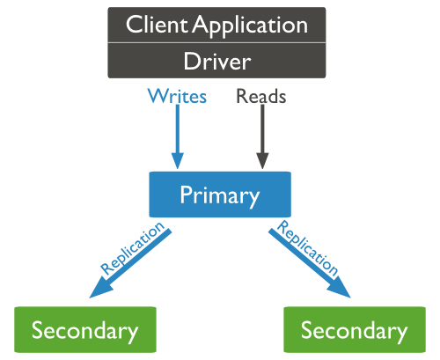
Replica Set Features
A cluster of N nodes
Any one node can be primary
All write operations go to primary
Automatic failover
Automatic recovery
Consensus election of primary
client application always interact with the primary node and the primary node then replicates the data to the secondary nodes.

Slide 57
MongoDB - Sharding
Sharding is the process of storing data records across multiple machines and it is MongoDB's approach to meeting the demands of data growth. As the size of the data increases, a single machine may not be sufficient to store the data nor provide an acceptable read and write throughput. Sharding solves the problem with horizontal scaling. With sharding, you add more machines to support data growth and the demands of read and write operations.
Why Sharding?
  In replication, all writes go to master node
  Latency sensitive queries still go to master
  Single replica set has limitation of 12 nodes
  Memory can't be large enough when active dataset is big
  Local disk is not big enough
  Vertical scaling is too expensive

Slide 58
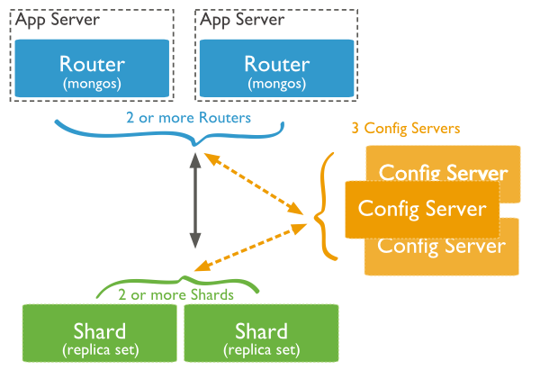
Sharding in MongoDB using sharded cluster.
Shards − Shards are used to store data. They provide high availability and data consistency. In production environment, each shard is a separate replica set.
Config Servers − Config servers store the cluster's metadata. This data contains a mapping of the cluster's data set to the shards. The query router uses this metadata to target operations to specific shards. In production environment, sharded clusters have exactly 3 config servers.
Query Routers − Query routers are basically mongo instances, interface with client applications and direct operations to the appropriate shard. The query router processes and targets the operations to shards and then returns results to the clients. A sharded cluster can contain more than one query router to divide the client request load. A client sends requests to one query router. Generally, a sharded cluster have many query routers.

Slide 59
MongoDB - Create Backup and restore data
mongodump - This command will dump the entire data of your server into the dump directory.
Mongorestore - To restore backup data

Slide 60
MongoDB – Java
https://www.tutorialspoint.com/mongodb/mongodb_java.htm
MongoDB – PHP
https://www.tutorialspoint.com/mongodb/mongodb_php.htm

Slide 61
Thank you

